Slide 1
Find the most popular node using Centrality
Name - Snehal Gandham
Student Id - 79007757

Slide 2
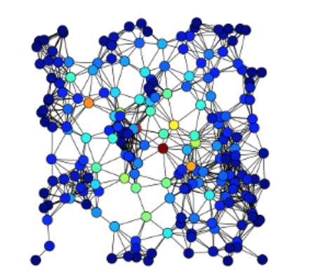
CENTRALITY
1_sgandham
In graph theory and network analysis, centrality highlights the most important vertices within a graph.

Slide 3
Variations
Total Centrality has been calculated by considering various Centralities has been considered such as
Betweenness Centrality using Brandes Algorithm
Closeness Centrality
Degree Centrality
Katz Centrality

Slide 4
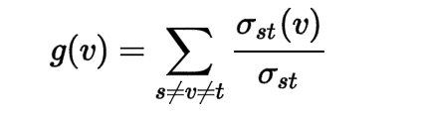
Betweenness centrality
The Betweenness Centrality for each vertex is the number of the shortest paths that pass through the vertex.
For example, in a telecommunication network, a node with higher Betweenness Centrality would have more control over the network, because more information will pass through that node.
The Betweeness Centrality is calculated by

Slide 5
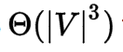
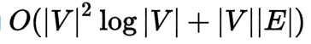
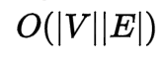
Brandes’ algorithm for betweenness centrality
Calculating the betweenness and closeness centralities of all the vertices in a graph involves calculating the shortest paths between all pairs of vertices on a graph, which takes time with the Floyd–Warshall algorithm.
On a sparse graph, Brandes’ Algorithm will take
On unweighted graph, Brandes’ Algorithm will take

Slide 6
Applications
1_sgandham
In a social network, the most important people can be identified (Betweenness Centrality.
Find who can be the gossipmonger among the list of friends(Degree Centrality).
The famous celebrity among a list of celebrities can be found (Degree Centrality).
The source cell responsible for the spread of the disease can be found (Betweeness Centrality).
The substation which can face the most load in a telephone network can be found (Closeness Centrality).
Patterns of Social Relationships can be found.

Slide 7




applications
Find Gossipmonger using Degree Centrality
Help re-route the traffic using Closeness centrality when substation goes down
Popular Person on Social Media
Help a scientist to find the disease causing cell

Slide 8
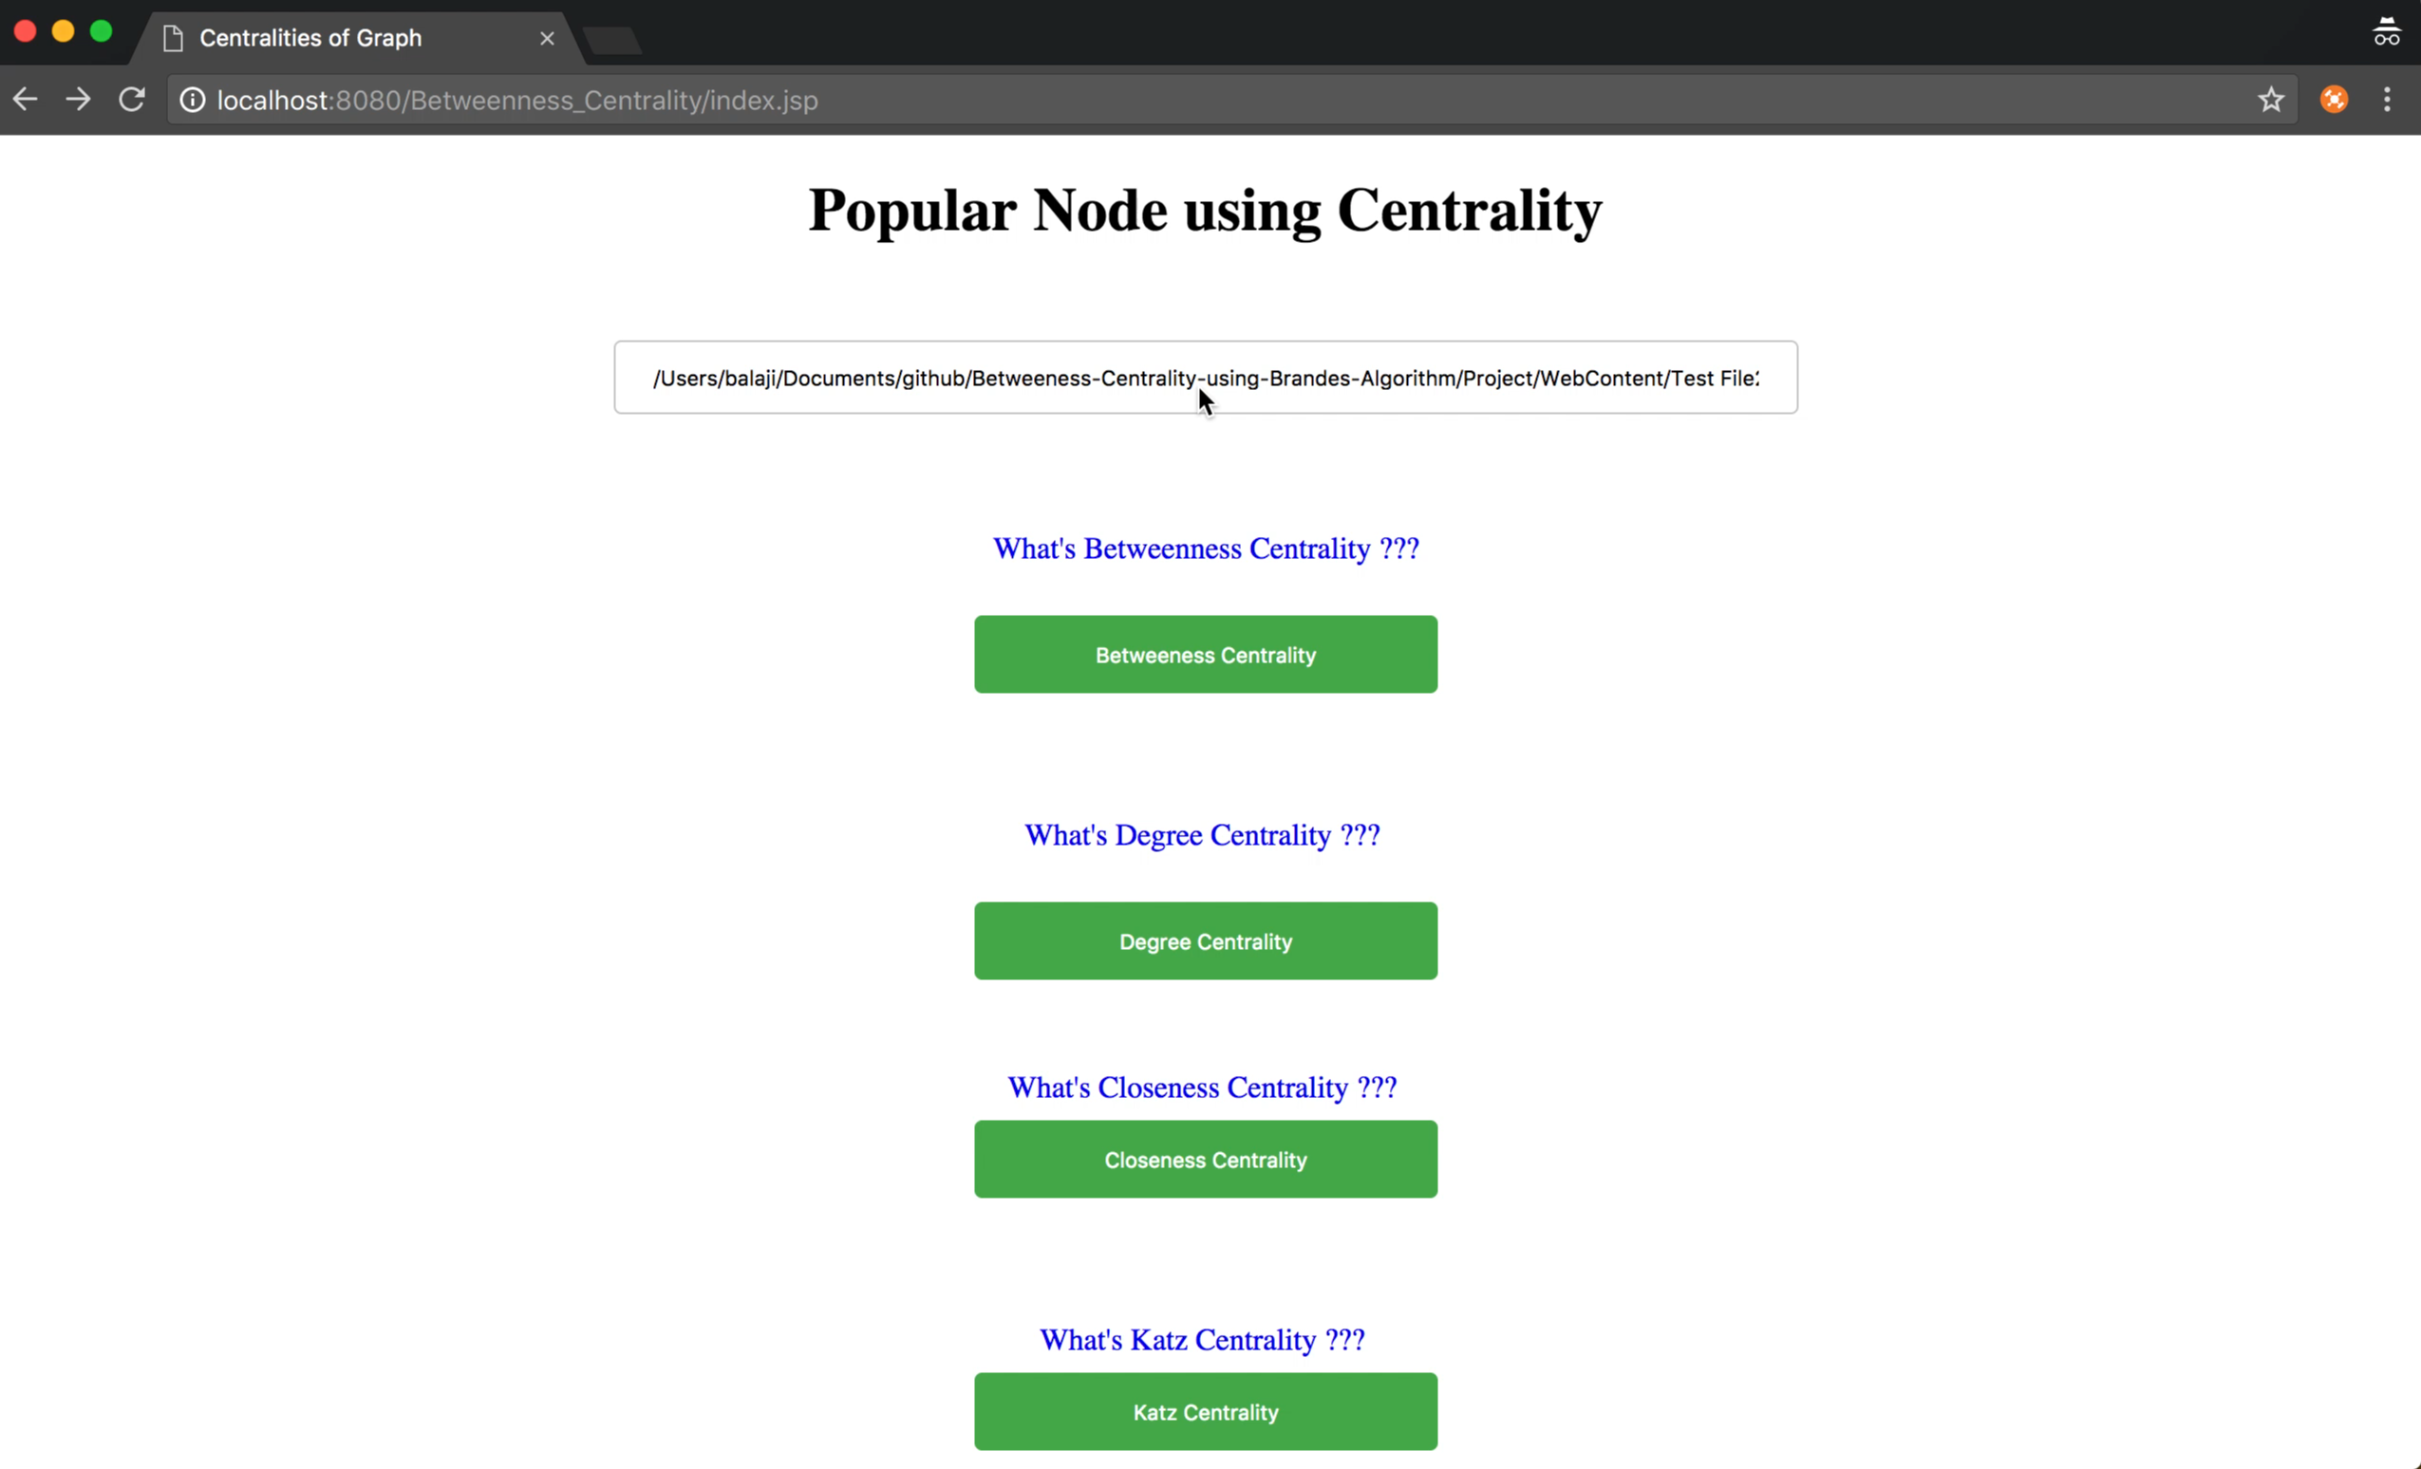
Video

